Slide 1

Pressure Controller project
Student: Youssef Samy Youssef
Email: yosefsamy019@gmail.com
Instructor: Eng. kerloes Khalil
Diploma: Learn in depth

Slide 2
GOALS
This Project targets:
Embedded C
Understanding Build Process
MakeFile
Startup
Linker Script
UML: unified modeling Language
Board: STM32 (arm processor)
Tool Chain: Arm-none-eabi

Slide 3
Project Idea
A ”client” expects you to deliver the software of the following system:
A pressure controller with an alarm in the cabin informs the crew of a cabin when the pressure exceeds 20 bars.
The Alarm duration has non specific duration.
The Alarm can be LED or Buzzer.

Slide 4
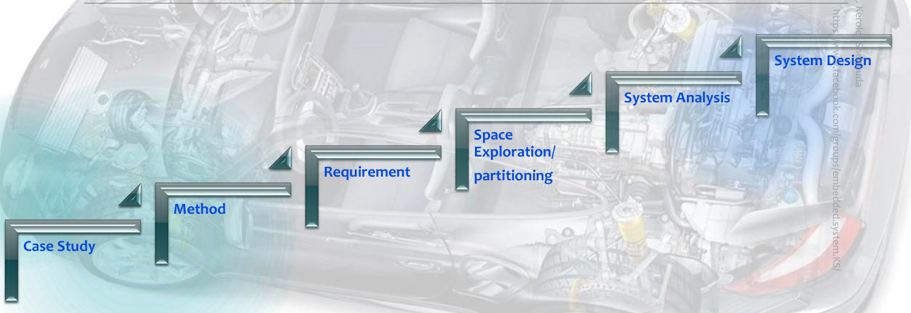
System Architecting
Case Study
Method
Requirements
Space Exploration
System Analysis
System Design

Slide 5
1. Case Study
Idea: A pressure controller with an alarm in the cabin informs the crew of a cabin when the pressure exceeds 20 bars.
Assumptions:
The controller set up and shutdown procedures are not modeled
The controller maintenance is not modeled
The pressure sensor never fails
The alarm never fails
The controller never faces power cut

Slide 6
2. Methods (SDLC)
The SW development can follow one of these life cycle:
Waterfall
V-model
Agile
Spiral
Actually, Selecting the SDLC is out of project scope right now.

Slide 7
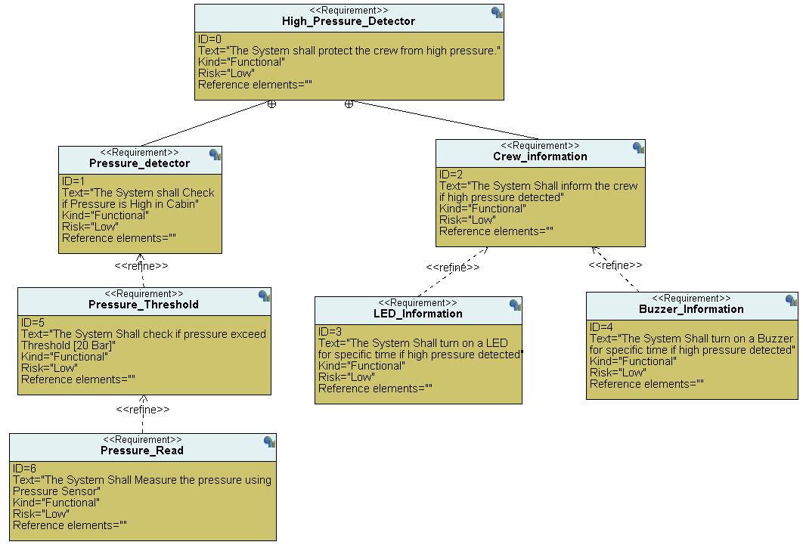
3. Requirements

Slide 8
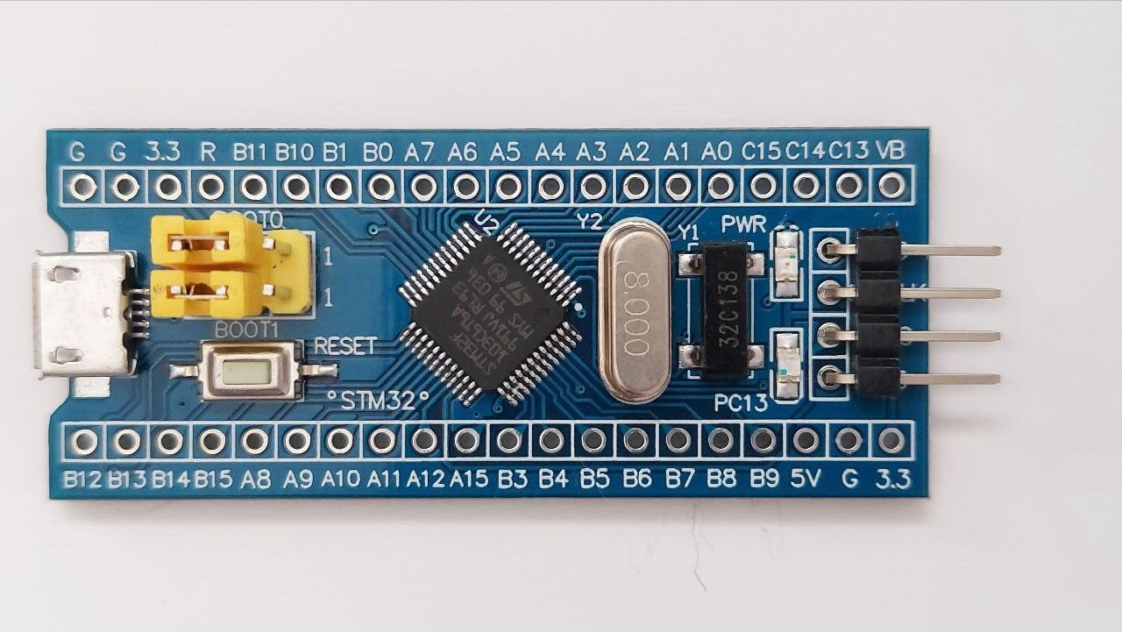
4. Space Exploration
The system will be implemented using STM32 board.
The processor used is: ARM-CORTEX-M

Slide 9
5. System Analysis
The System analysis is divided into 3 diagrams:
Case Diagram
Activity Diagram
Sequence Diagram

Slide 10
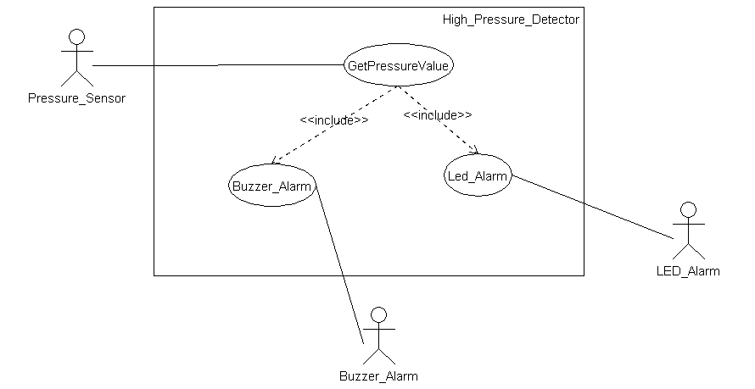
5.1 Case Diagram
This Diagram defines the boundary of the system:

Slide 11
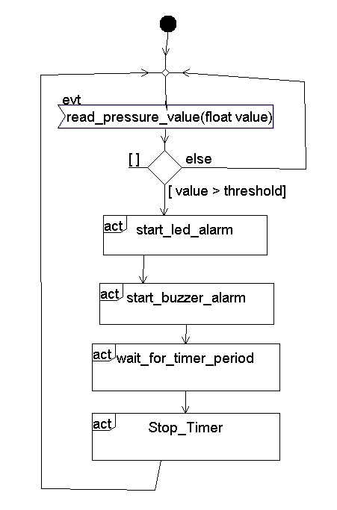
5.2 Activity Diagram
This Diagram describe the workflow behavior of a system:

Slide 12
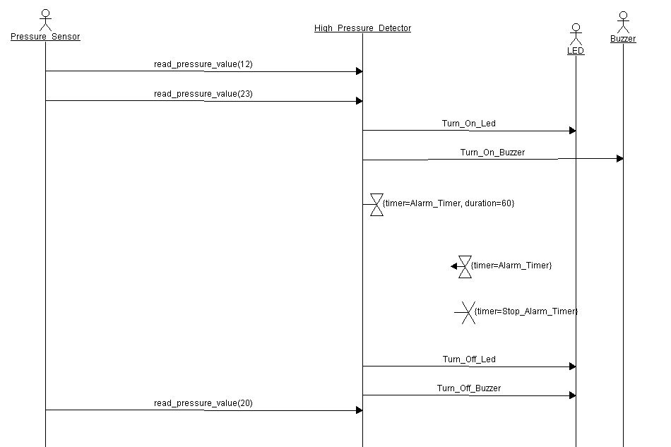
5.3 Sequence Diagram
An interaction diagram that details how operations are carried out.

Slide 13
6. System Design
Design required the system using block diagrams and state machine.
Use TTool Program to make design

Slide 14
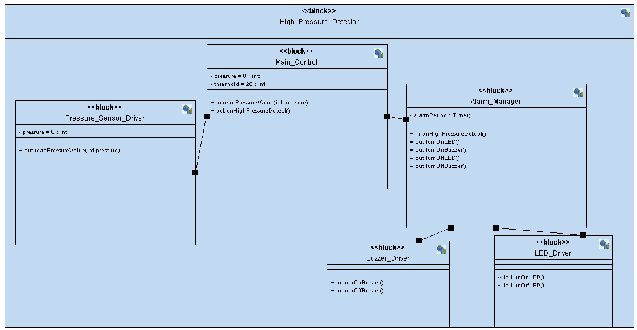
6.1 Block Diagram

Slide 15
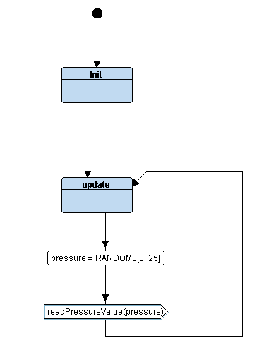
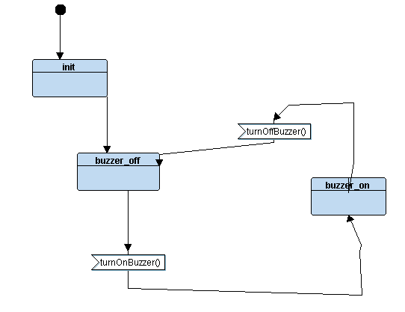
6.2 State Machines
Pressor Sensor Driver
Buzzer Driver

Slide 16
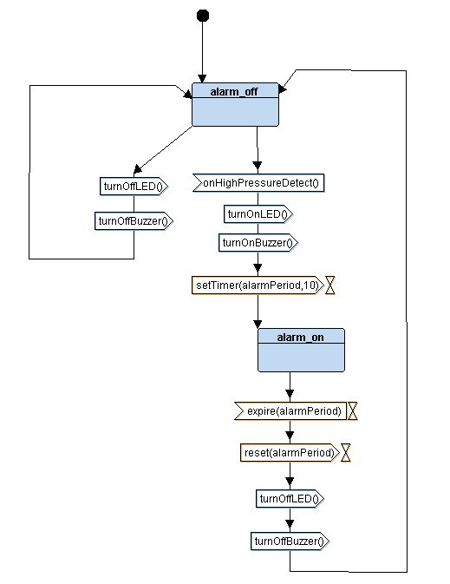
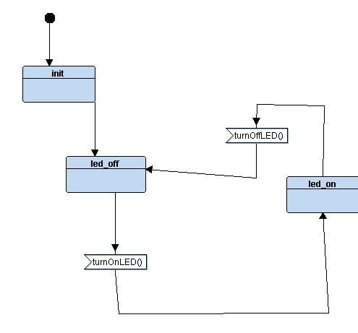
6.2 State Machines
Alarm manager
Led Driver

Slide 17
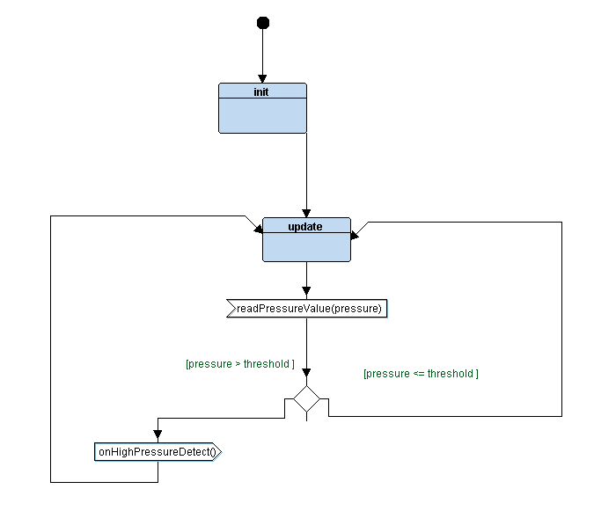
6.2 State Machines
Main Control

Slide 18
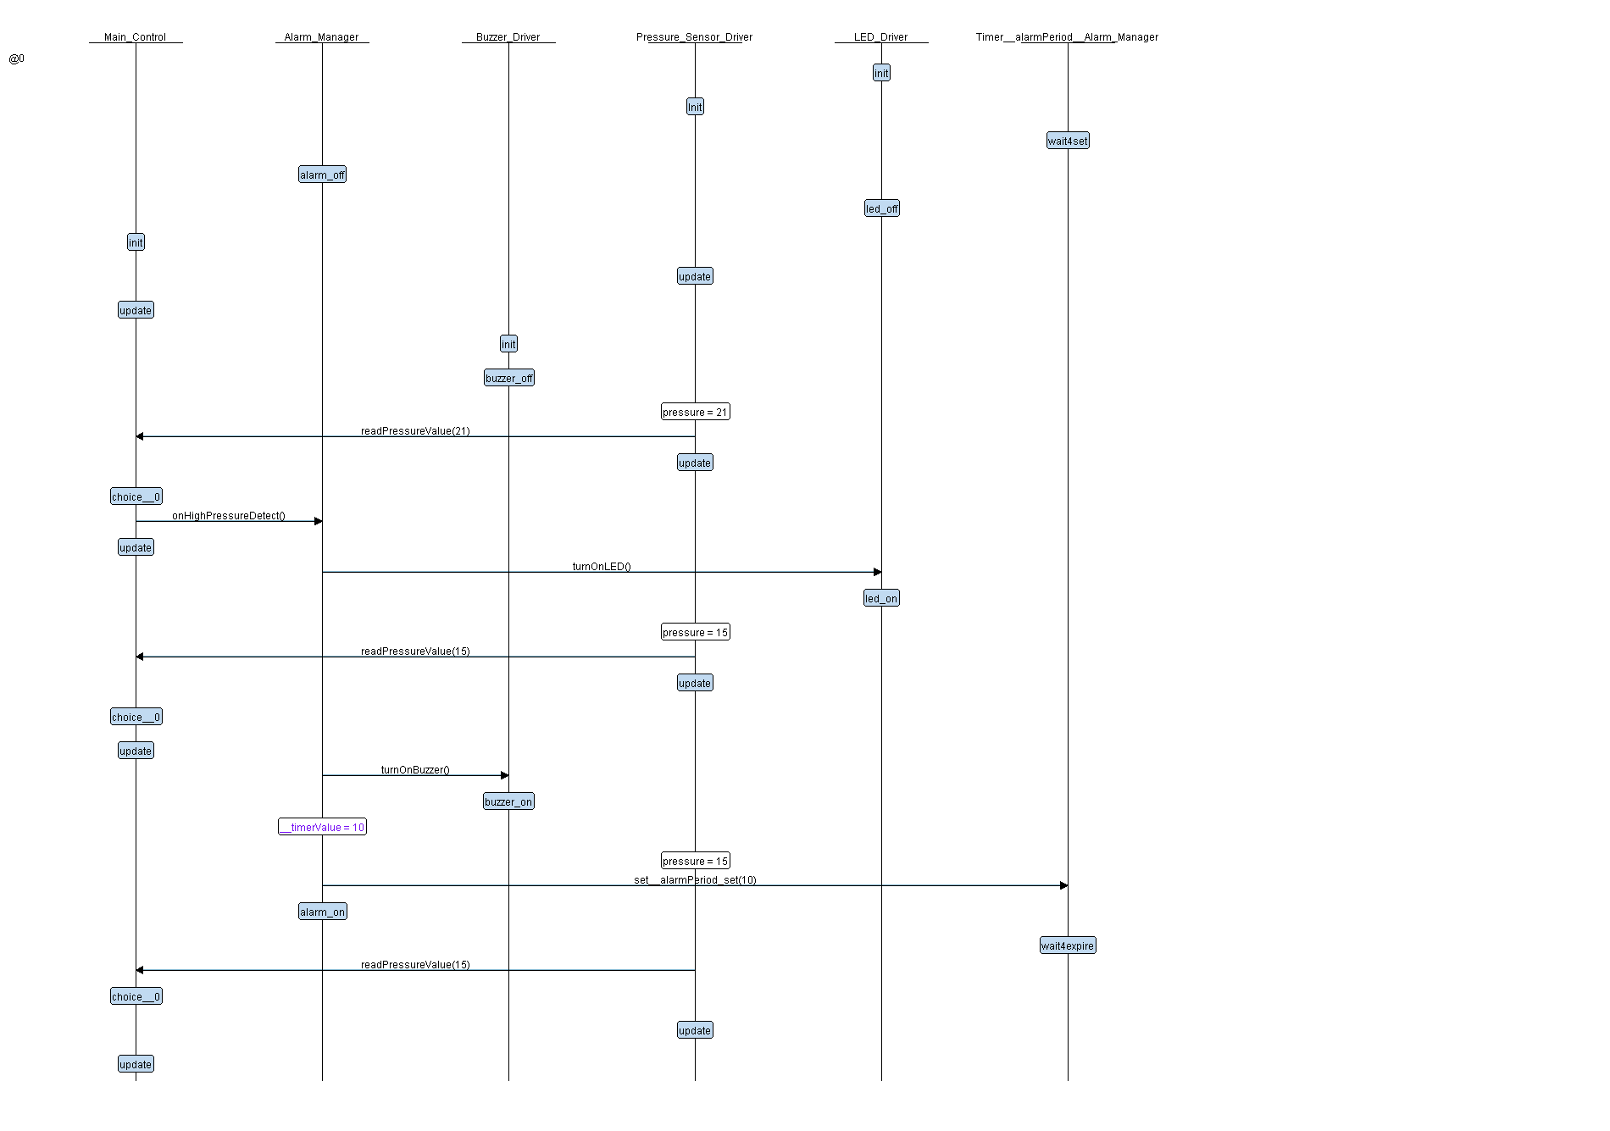
6.3 Simulate the system

Slide 19
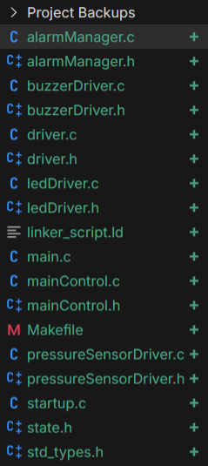
7. Project Implementation
Language: C
Board: STM32
Write own Makefile, Linker Script, Startup
Each block diagram is implemented in 2 files:
.c &.h

Slide 20
7. Project Implementation
The code is available on my Account on GitHub.

Slide 21
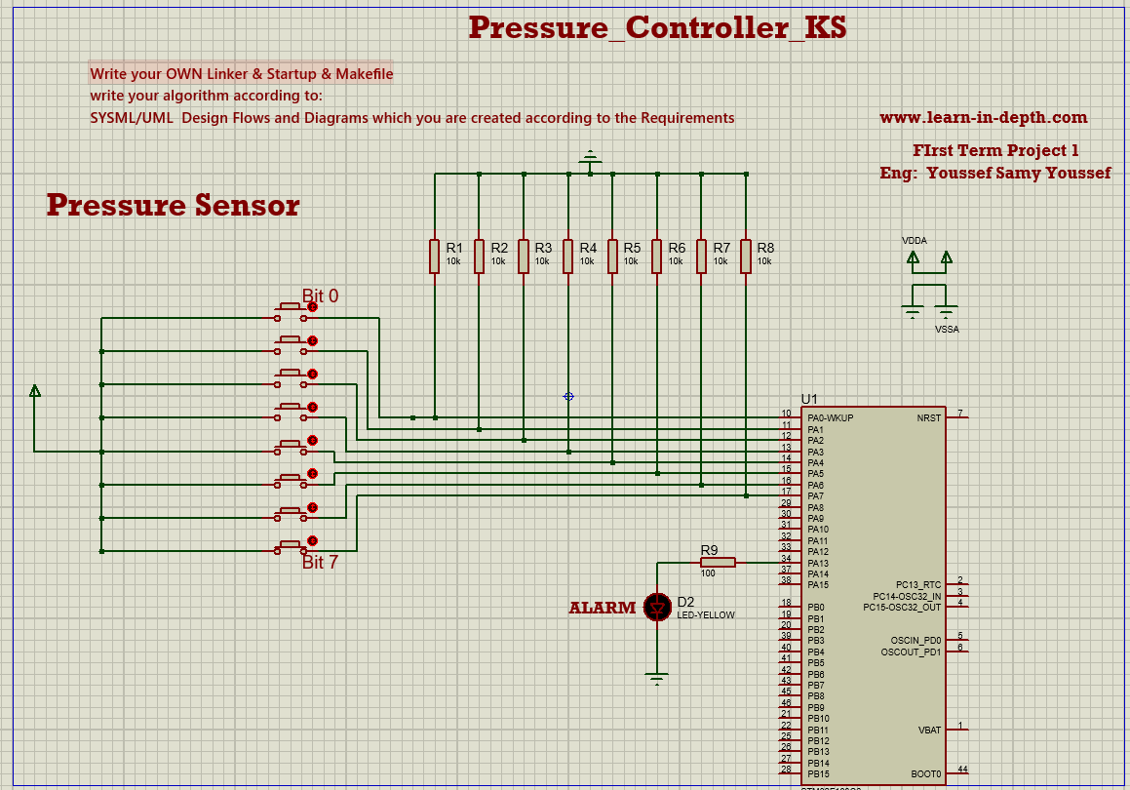
8. Proteus Simulation

Slide 22
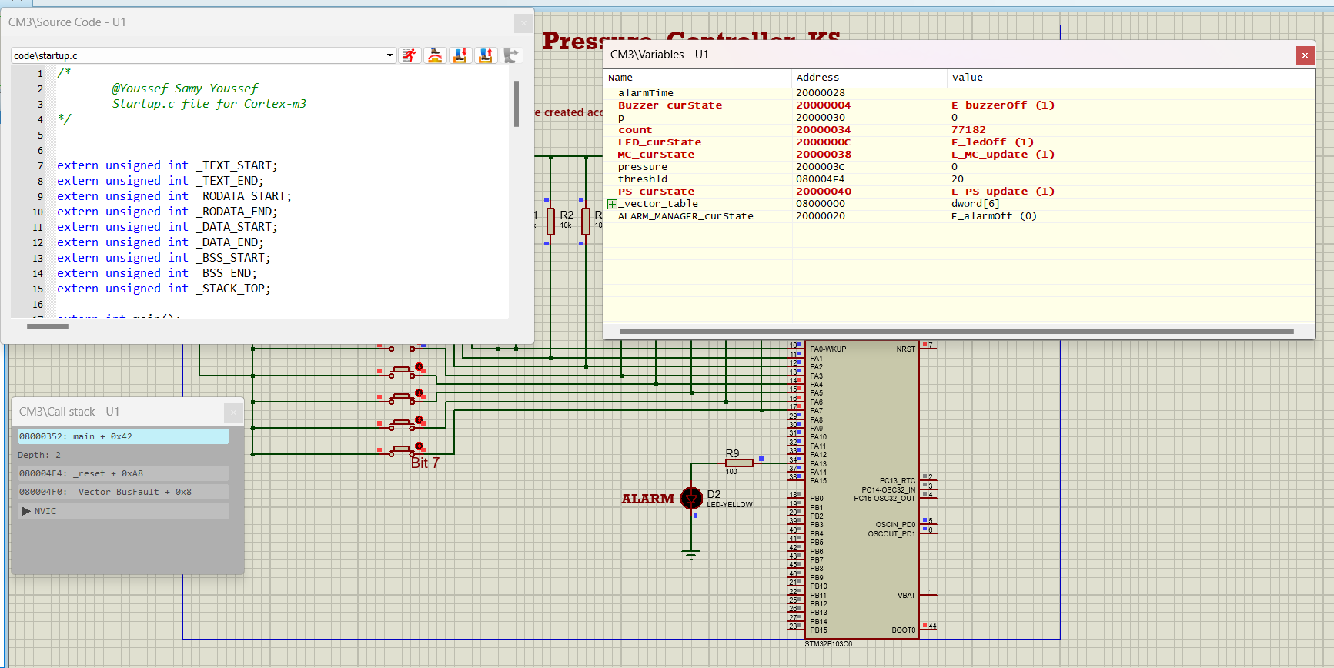
8. Proteus Simulation

Slide 23
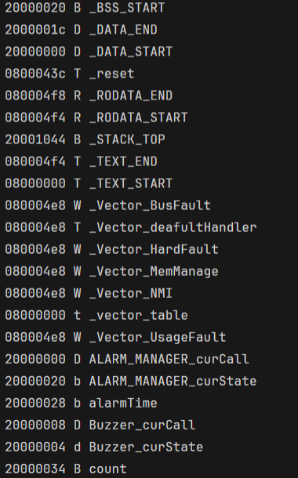
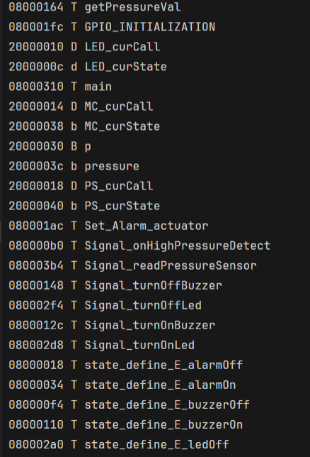
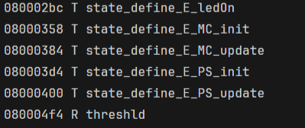
9. Binary Utilitis (nm)

Slide 24
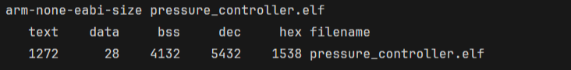
9. Binary Utilitis (size)

Slide 25
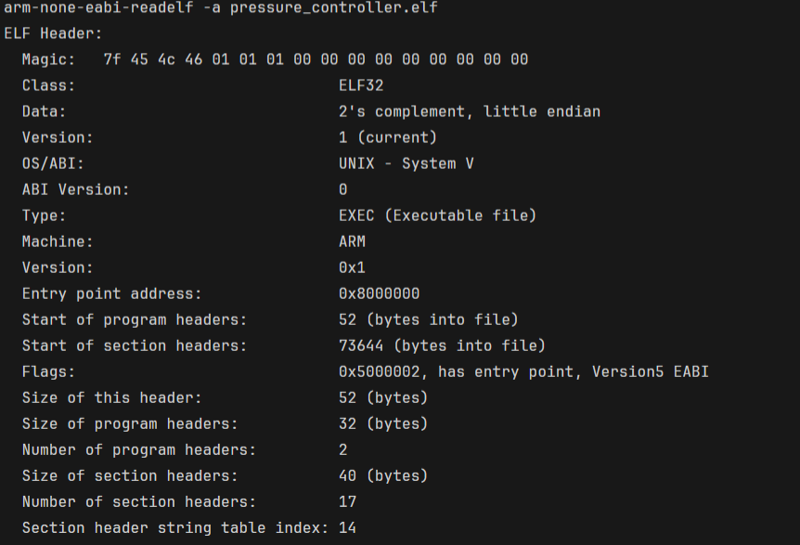
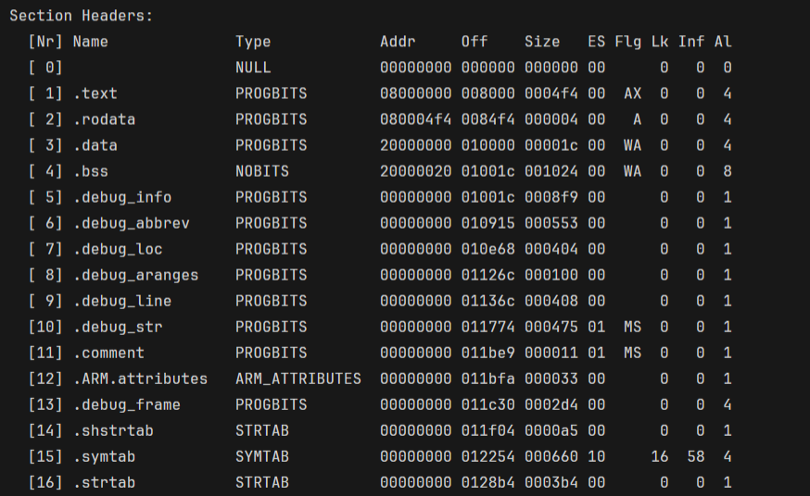
9. Binary Utilitis (readelf)

Slide 26
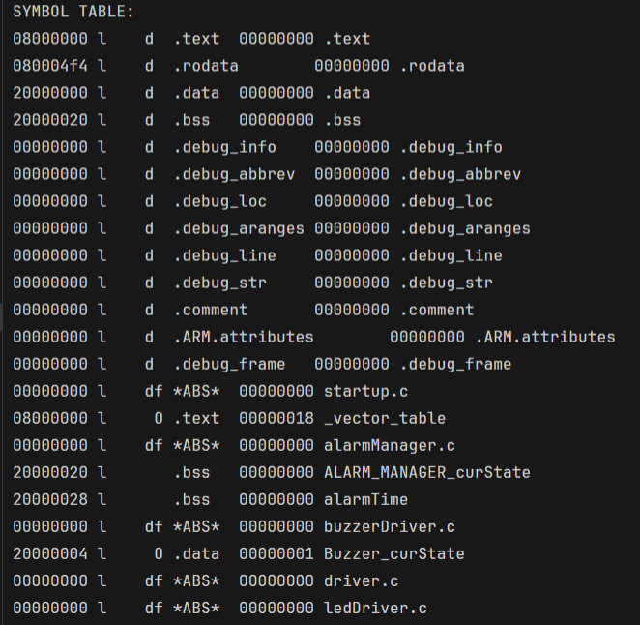
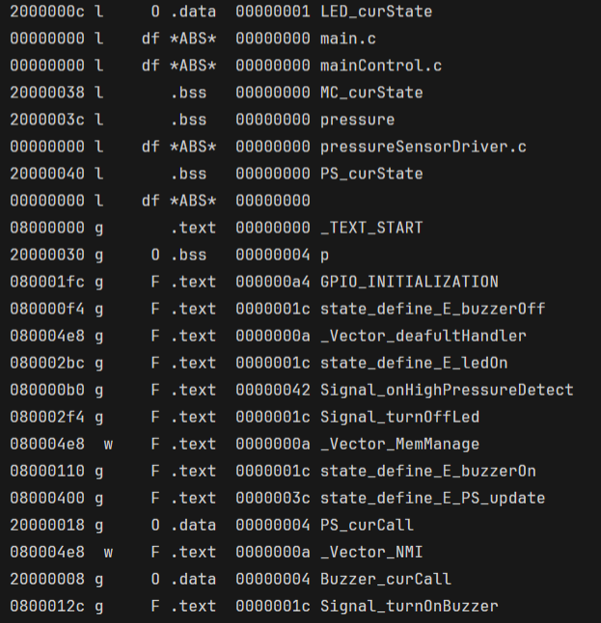
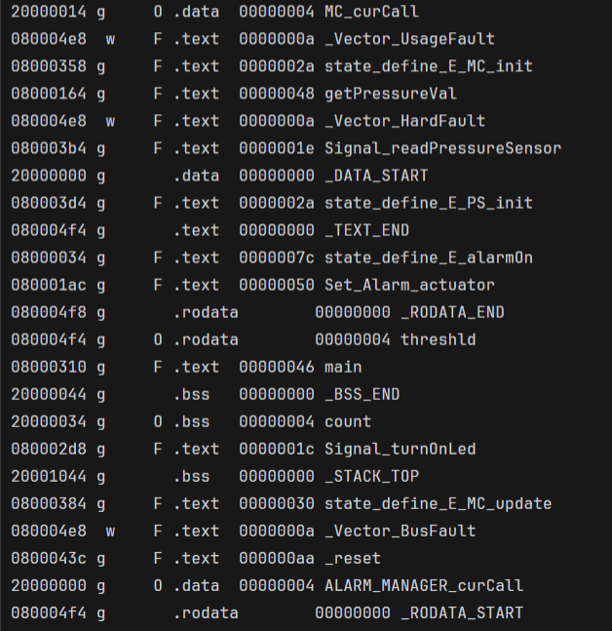
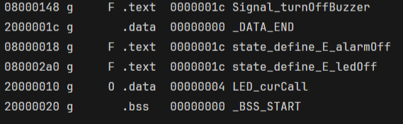
9. Binary Utilitis (objdump)

Slide 27
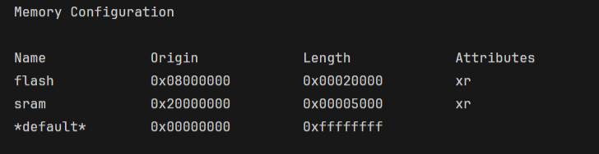
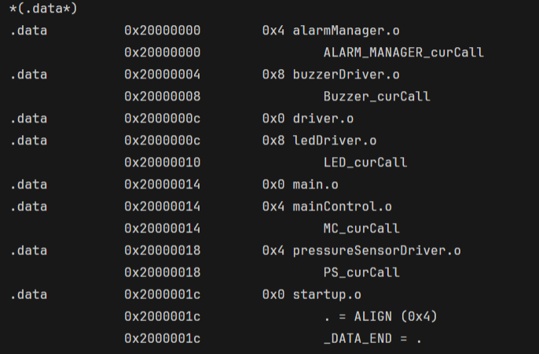
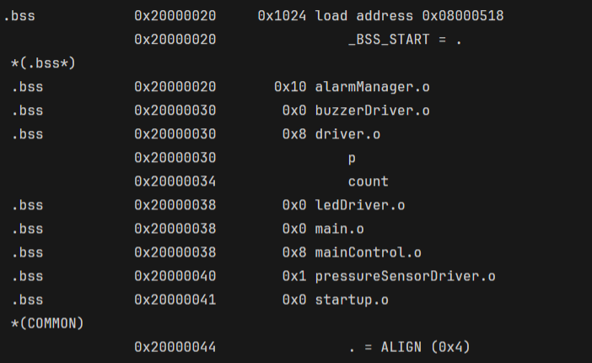
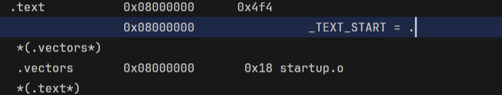
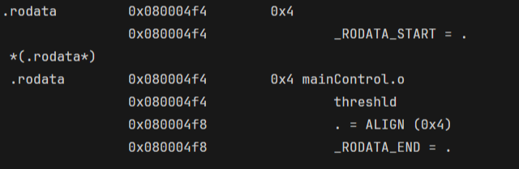
10. Map File

Slide 28
Thank You

